Slide 1
Infected innate immune cells hint at the cause of severe COVID
Minghao Gong

Slide 2
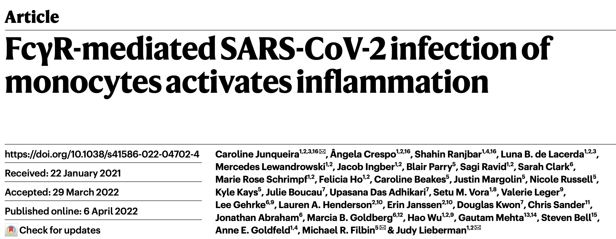

Slide 3
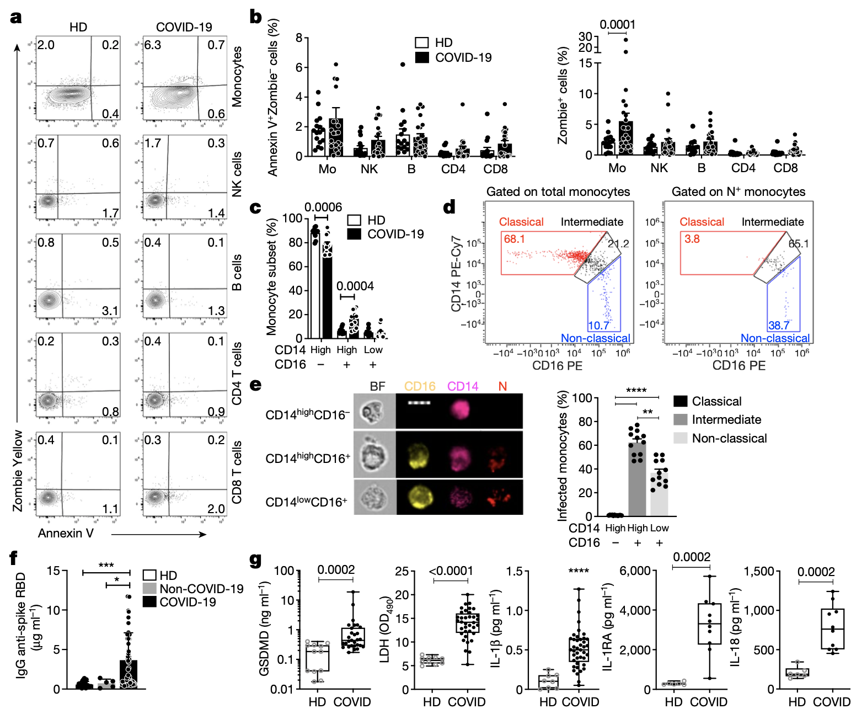
COVID-19 blood shows signs of pyroptosis
Notes:
Fig 1

Slide 4
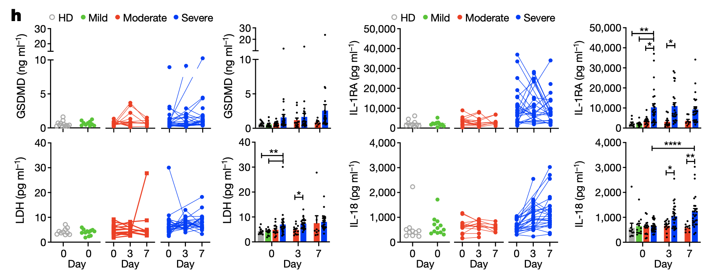
Pyroptosis biomarkers correlate with COVID-19 disease severity
Notes:
Fig 1.

Slide 5
Monocytes have activated inflammasomes

Slide 6
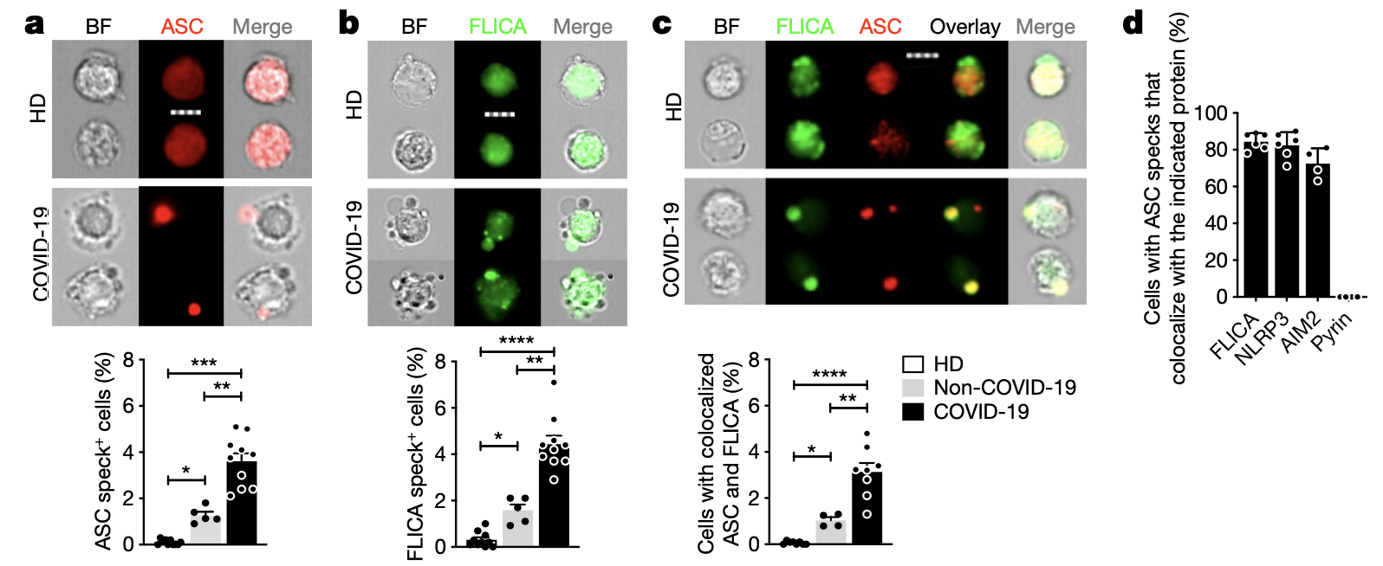
Monocytes have activated inflammasomes –ASC/FLICA

Slide 7
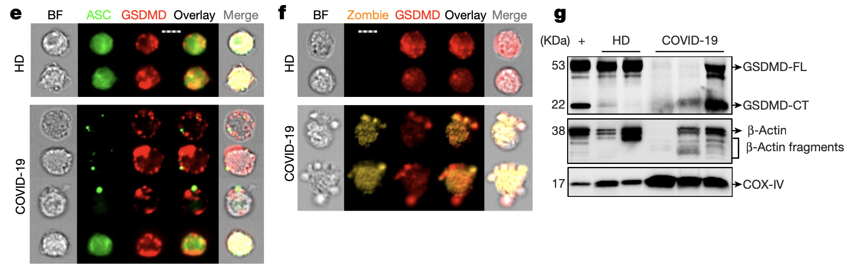
Monocytes have activated inflammasomes – GSDMD

Slide 8
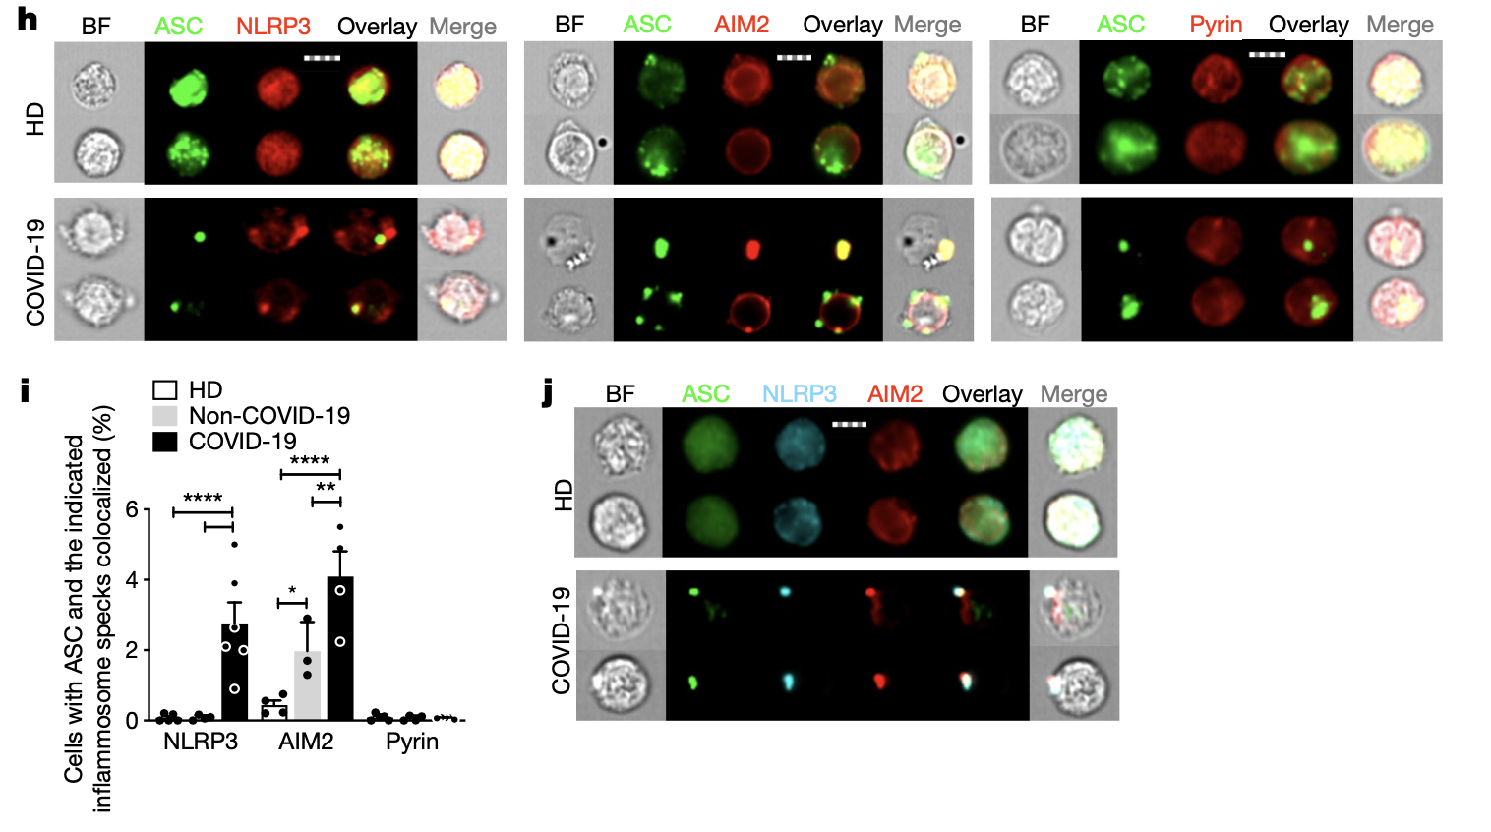
Monocytes have activated inflammasomes – NLPR3/AIM2

Slide 9
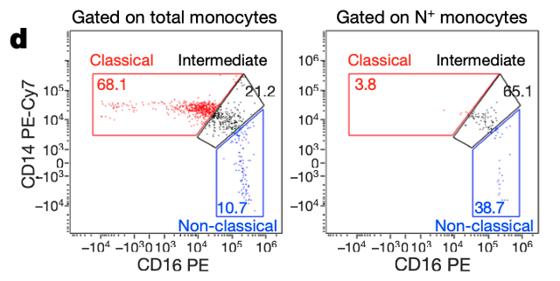
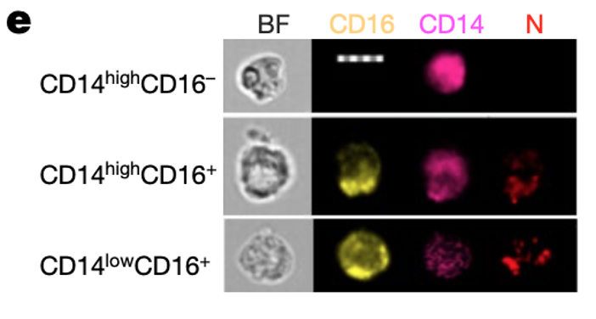
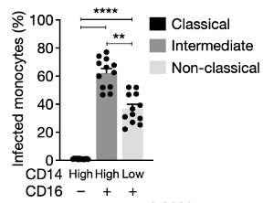
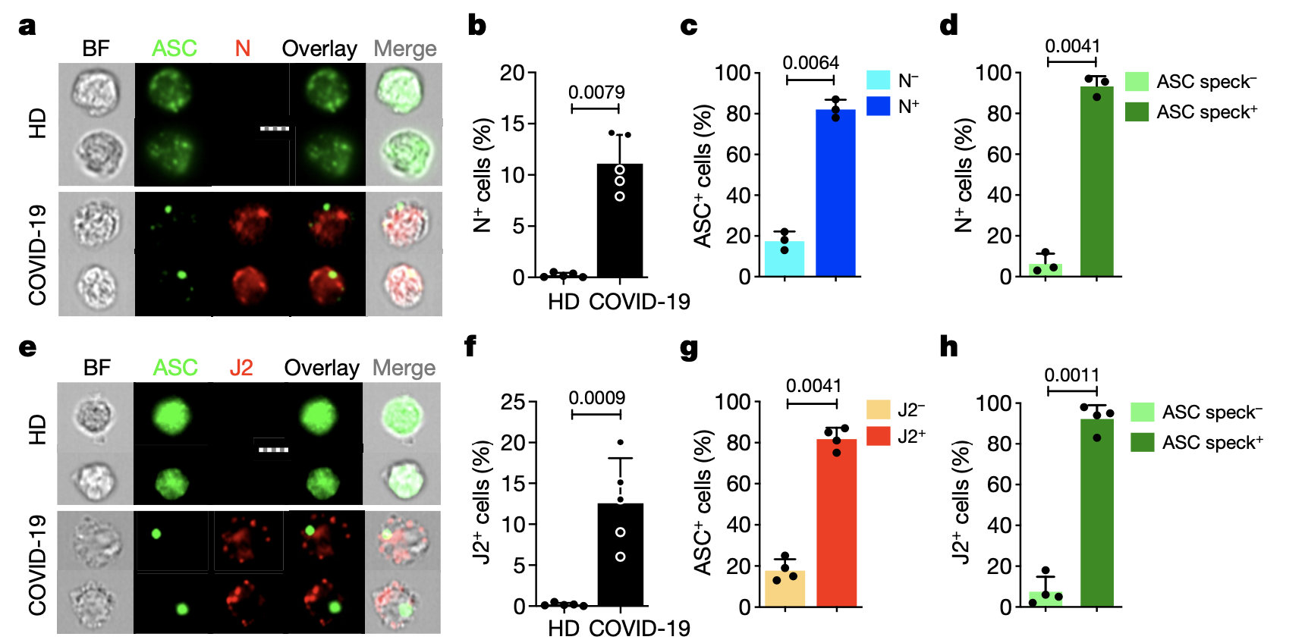
Monocyte infection triggers pyroptosis

Slide 10
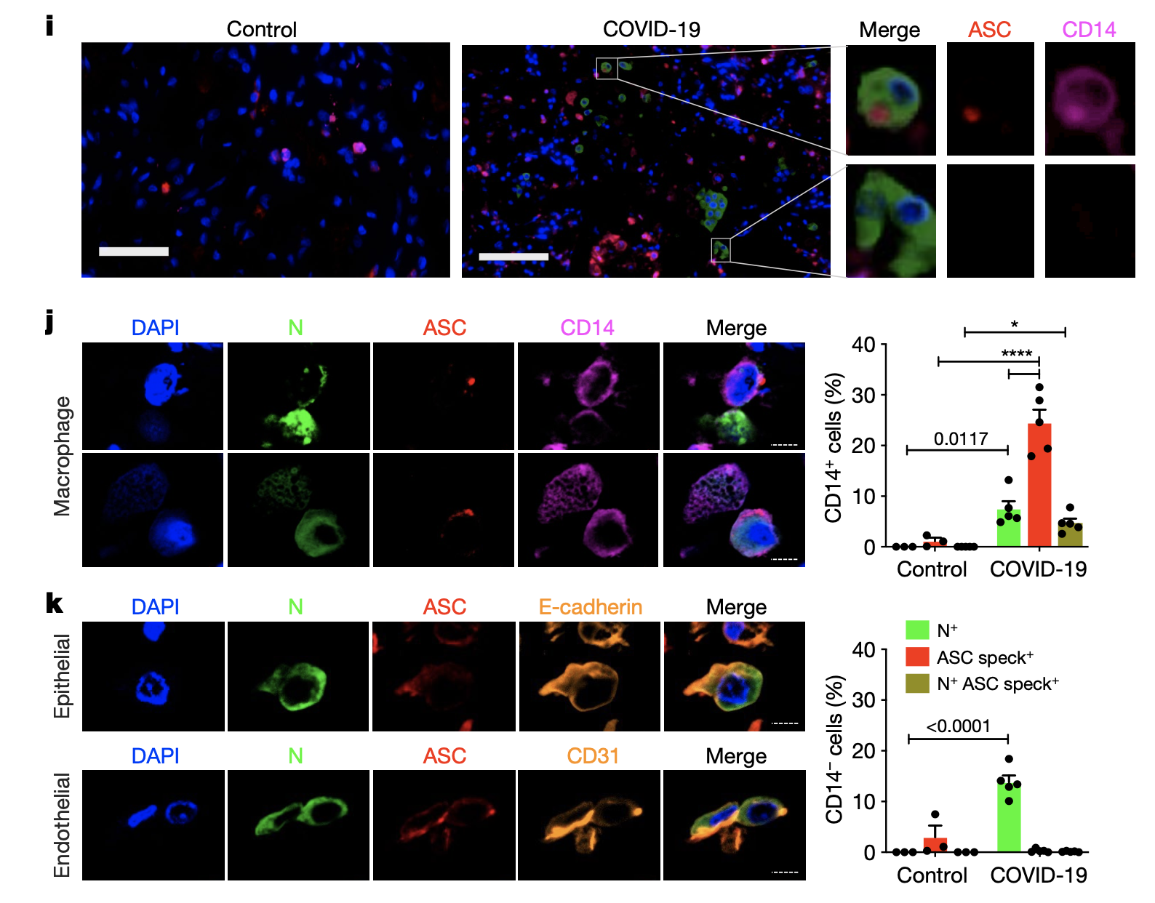
Lung macrophages have inflammasome specks

Slide 11
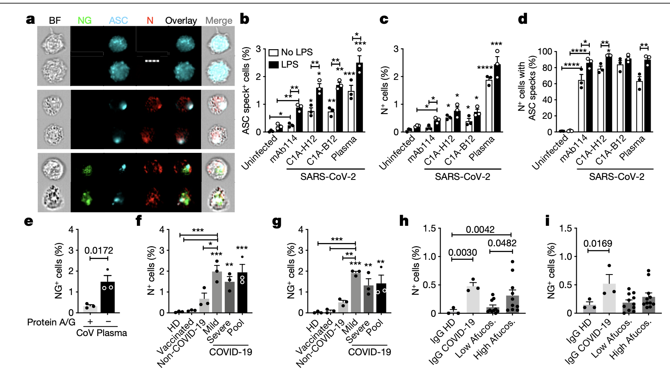
CD16 mediates infection of opsonized virus

Slide 12
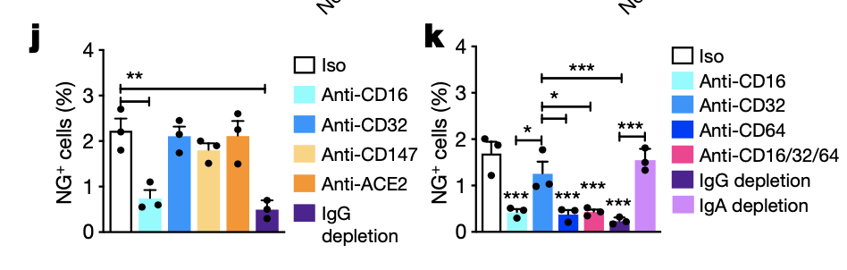

Slide 13
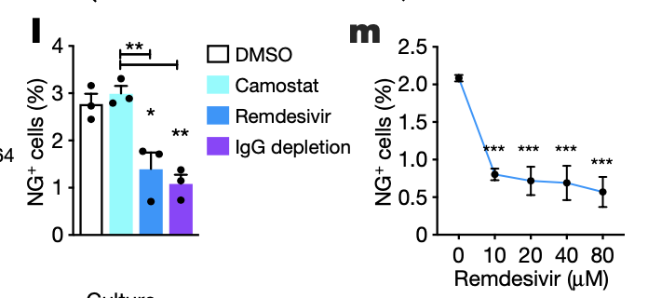
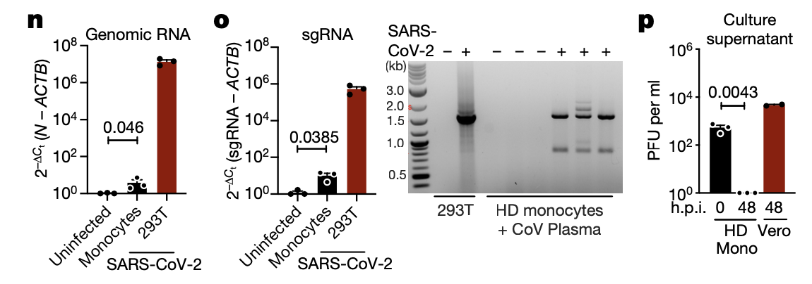
SARS-CoV-2 monocyte infection is aborted

